Slide 1

Arduino GSM Security System

Slide 2

Contents
Project Goals
Hardware Used
Software Used
Schematics
Demonstration
Obstacles
Conclusion

Slide 3

Project Goals
Simple and User Friendly System
Spot Security Breach Response
Microcontroller circuitry synchronized with the GSM module
Distant Notification

Slide 4


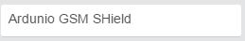
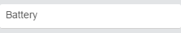
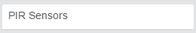
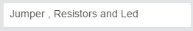

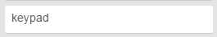
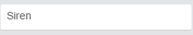


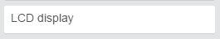
Hardwares Used

Slide 5
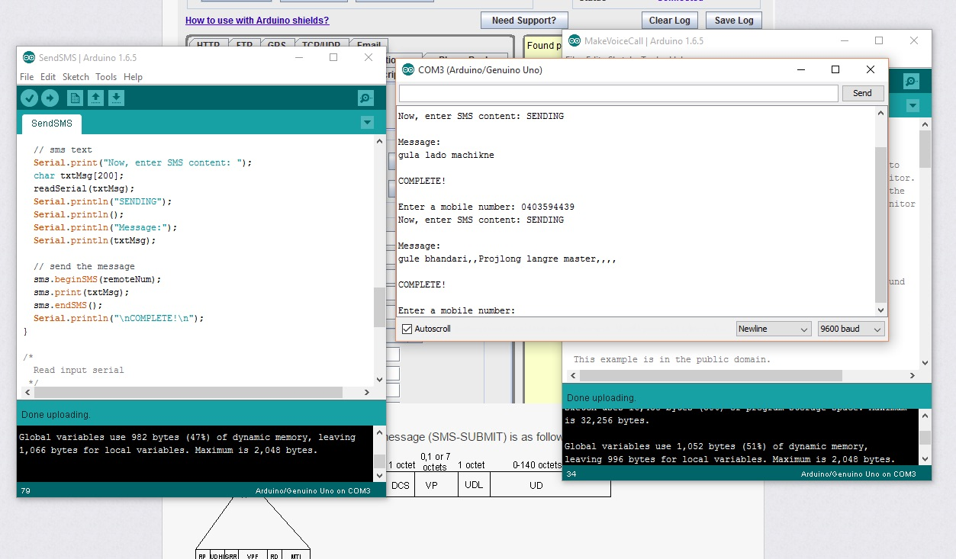
Software Used

Slide 6
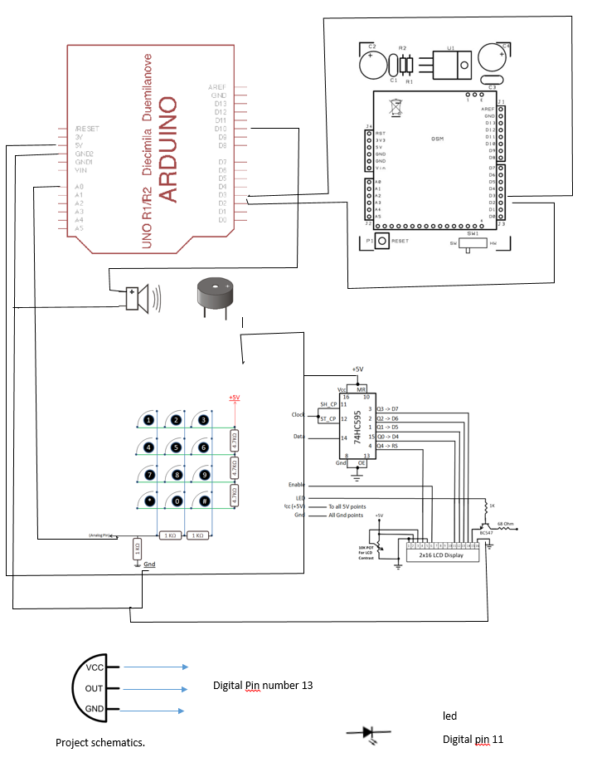
Schematics

Slide 7
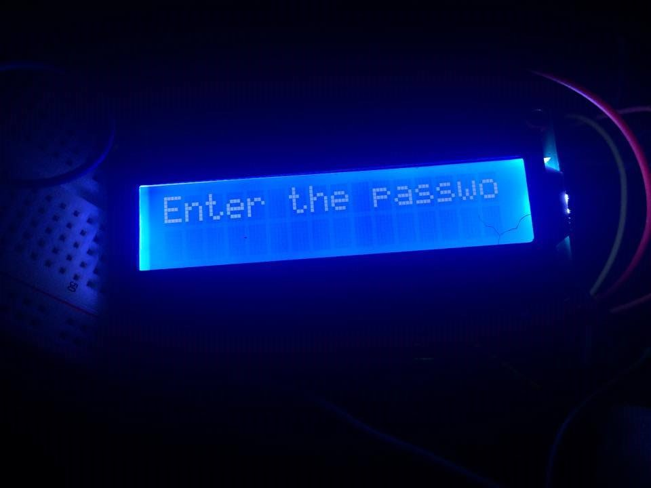
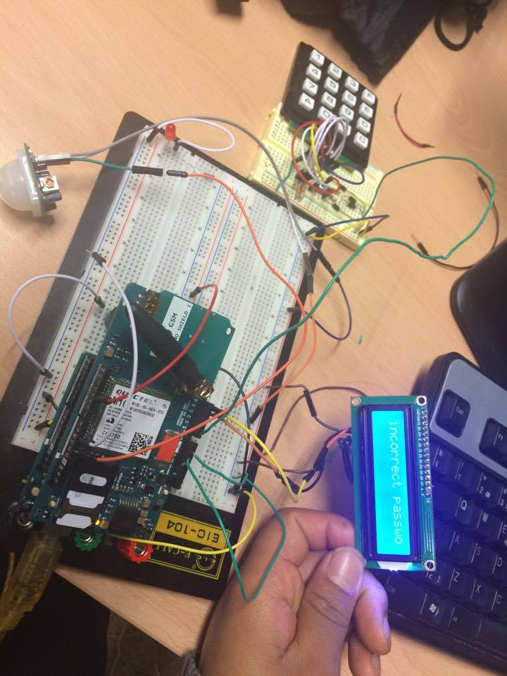
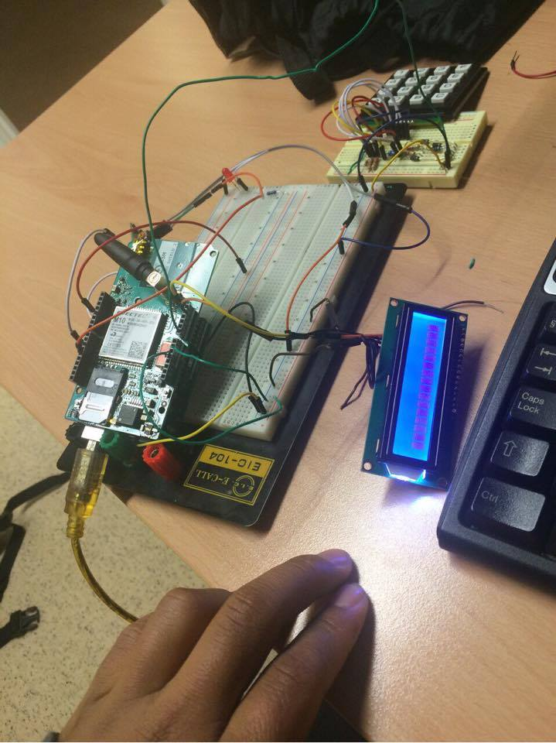
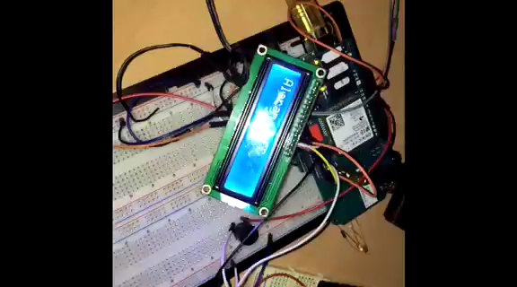
Demonstration

Slide 8
Obstacles
Late arrival of GSM Shield
Difficulty in compiling codes for calling and message
Camera Installations ( later the idea was abondoned due to memory issues)
Issues with GSM Shields external power supply

Slide 9
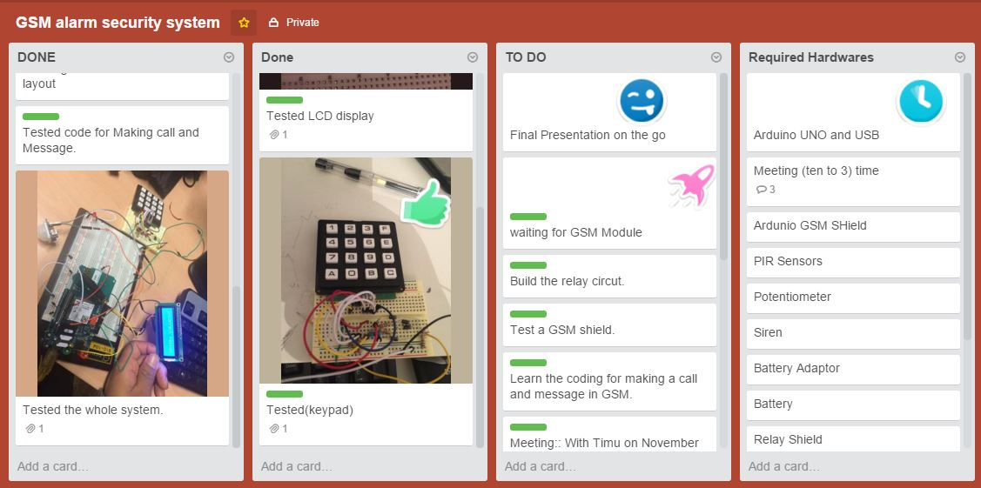
Conclusion
Achieved our project goals on time.
Due to memory issues live streaming or imaging system could not be implemented
During the project we realised the importance of task management
Being Punctual on the Meetings
Keeping track of records and updates

